Slide 1
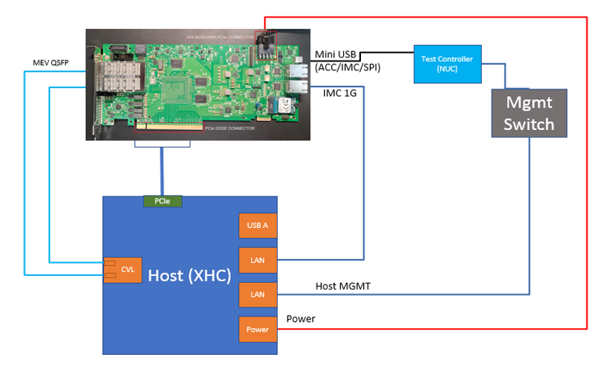
Config-K (DASH Lab Setups)

Slide 2
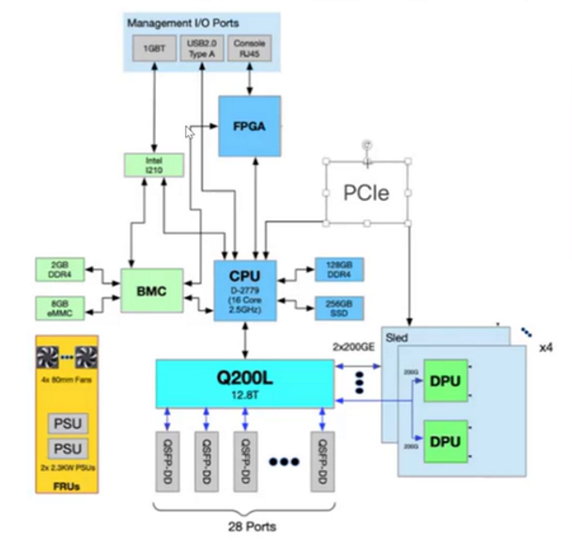

serial connection
Cisco Smart Switch 1
P11
P6
Bcom
Cisco Smart Switch 1 Lab Setup
32 Ports

Slide 3
Cisco Smart Switch 2
P7
P2
Cisco Smart Switch 2 Lab Setup
32 Ports

